Slide 1



MINI PROJECT REVIEW:
DEPARTMENT OF
COMPUTER SCIENCE ENGINEERING
GUIDE:
DR S HARIHARAGOPALAN (ASSOCIATE PROFESSOR)
MEMBERS:
SRIDHAR (1801227)
VIGNESHWARAN (1801250)
VISNUPIRIYAN (1801258)
VENGATESH (1801267)
HEALTHCARE MANAGEMENT USING BLOCKCHAIN.

Slide 2


AGENDA:
Problem Statement
Solution, Scope and Application
Software Requirement
Use case Diagram
Flow Chart
Literature Survey
Screenshots

Slide 3
PROBLEM STATEMENT:
In healthcare, Electronic health record(EHR)generally contain highly-sensitive and critical data related to patients, which is frequently shared among clinicians, radiologists, healthcare providers, pharmacists, and researchers, for effective diagnosis and treatment. Hence use suitable technology for accessing and managing the privacy and security of patient data and history in clinical practices.

Slide 4
SOLUTION AND SCOPE :
The project aims at designing a prototype for a simple blockchain based application for EHRs that satisfies some requirements like information privacy, traceability, secure information access and sharing in a decentralized fashion.
The prototype will be implemented with Hyperledger Fabric(HL Fabric) and will serve also as an access control system to manage identities, provide traceability and preserve the privacy of users and patients.
The system could potentially be used as a backup for health companies and be used in extreme situation to ensure the continuity of treatment while preserving privacy and confidentiality.

Slide 5
APPLICATION:
Patients Navigation panel consists of Dash board, Book appointment, Appointment history, Medical history.
Doctors Navigation panel consists of Dash board, Appointment history, Patients (Add and Manage), Search(By Name or Mobile No).
Admin Navigation panel consists of Dash board, Doctors, Doctors session logs, User, User session logs, Reports, Patients search, Appointment history.
Each of Tabs in navigation panel has its own specific functionalities.

Slide 6
SOFTWARE REQUIREMENTS:
SNO | SOFTWARES USED
1. | HTML, CSS and PHP
2. | Windows 10(64 bits)
3. | Node Js and VS code
4. | Phpmyadmin

Slide 7
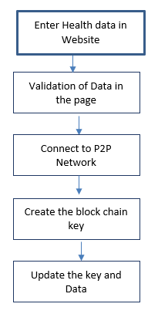
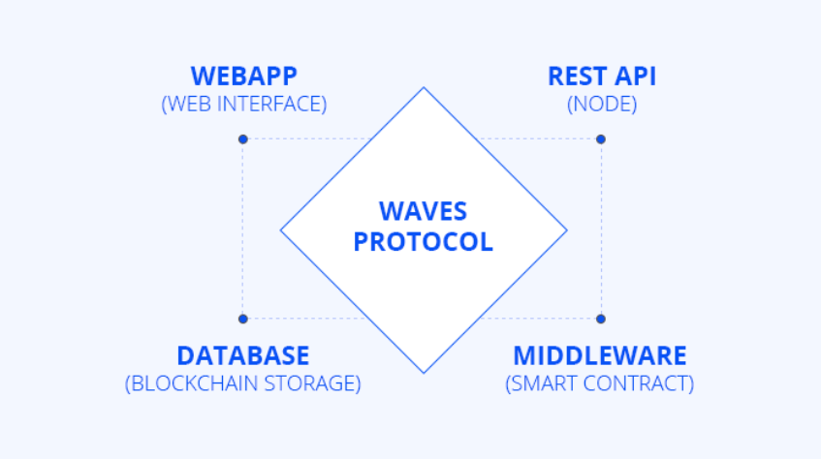
USECASE DIAGRAM:

Slide 8
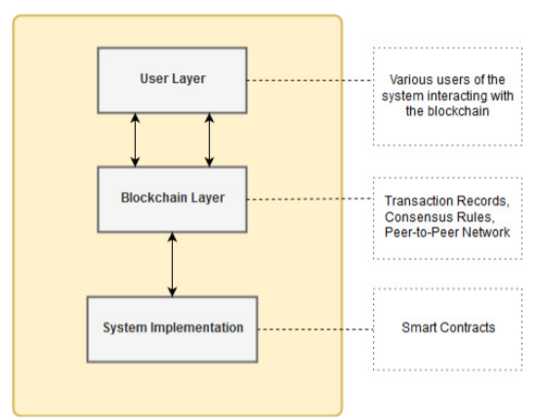
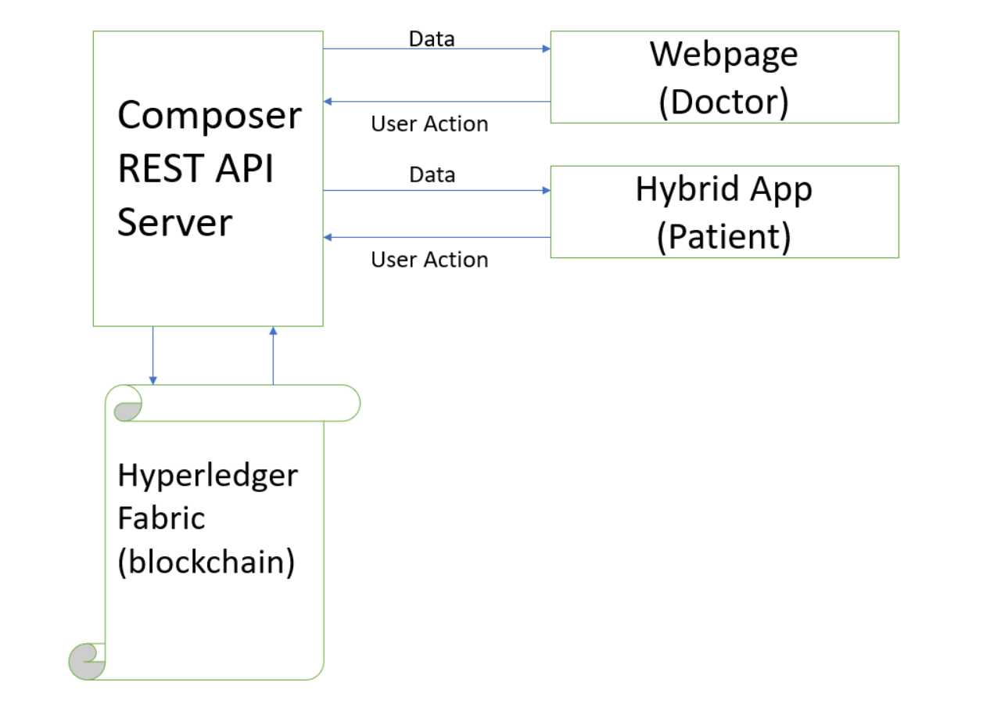
FLOW CHART:

Slide 9
LITERATURE SURVEY:
https://www.projecttopics.org/design-implementation-health-care-management-system.html
https://www.researchgate.net/publication/334587568_Interlinked_Hospital_Management_System
https://www.javatpoint.com/blockchain-tutorial
https://ieeexplore.ieee.org/document/7870552

Slide 10
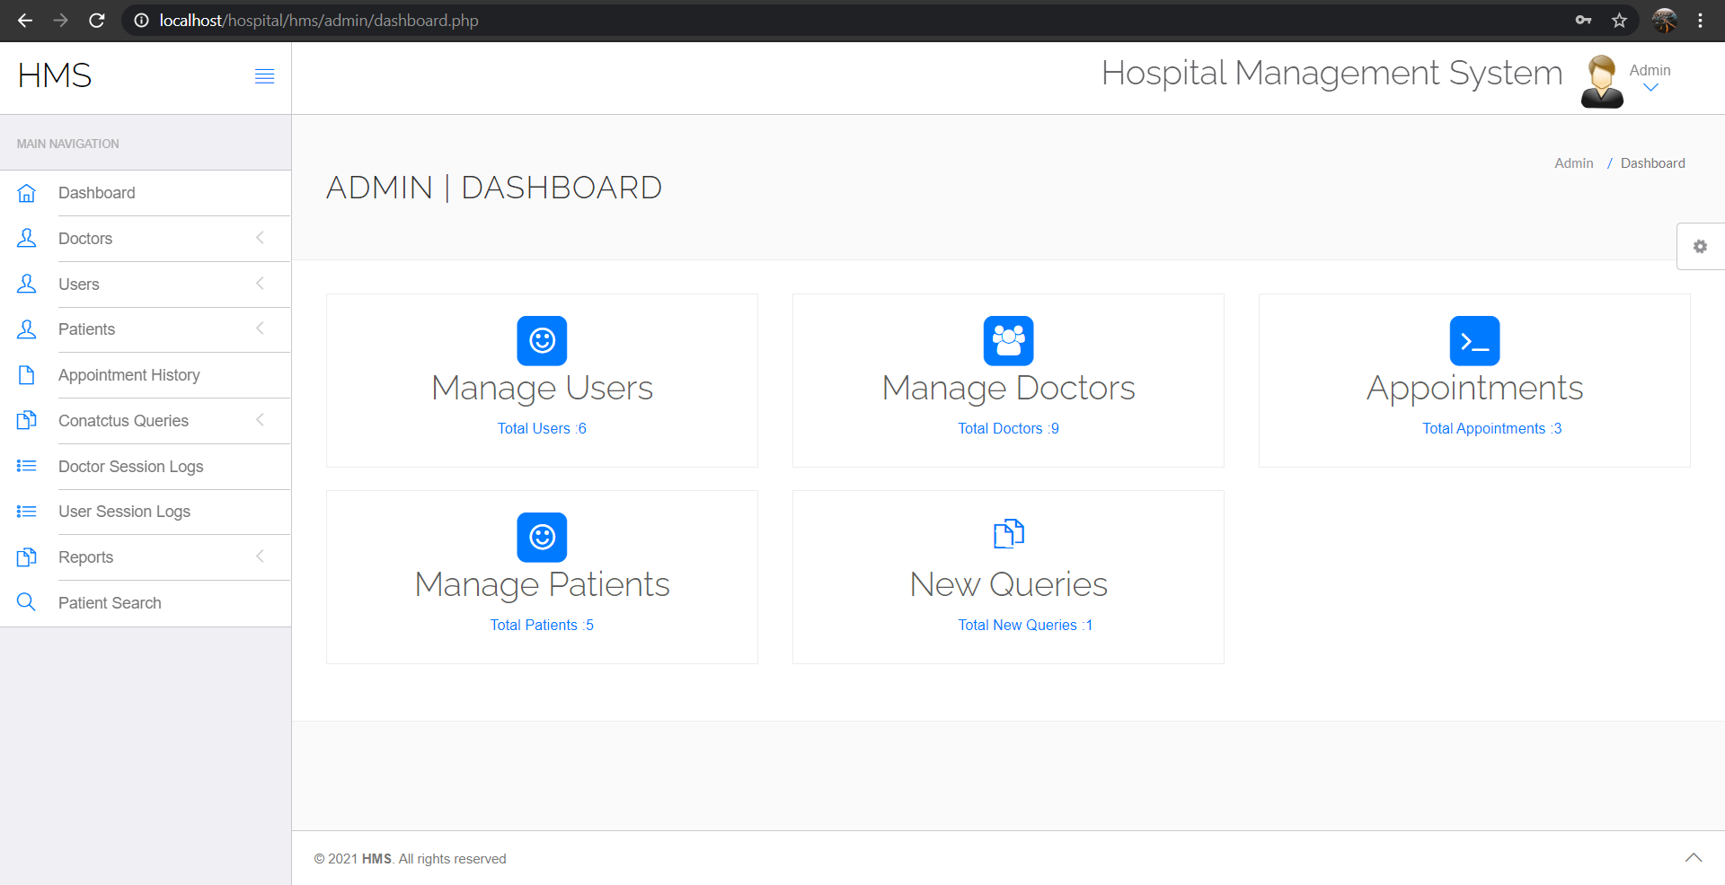
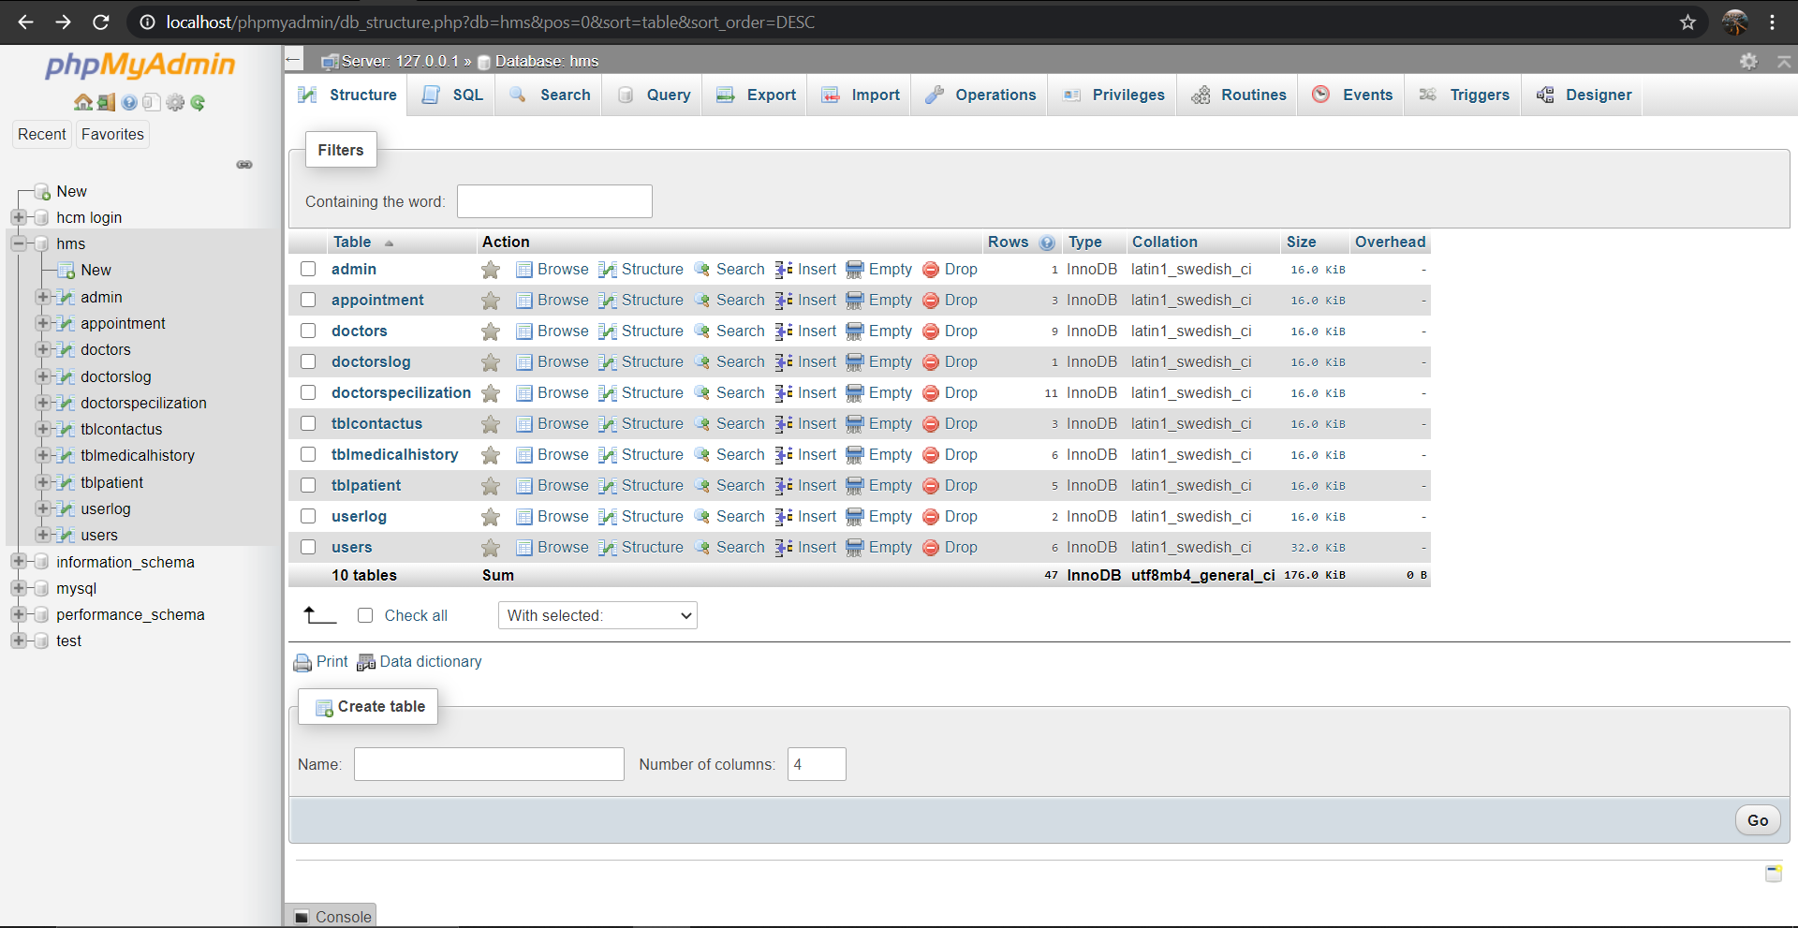
SCREENSHOTS:

Slide 11
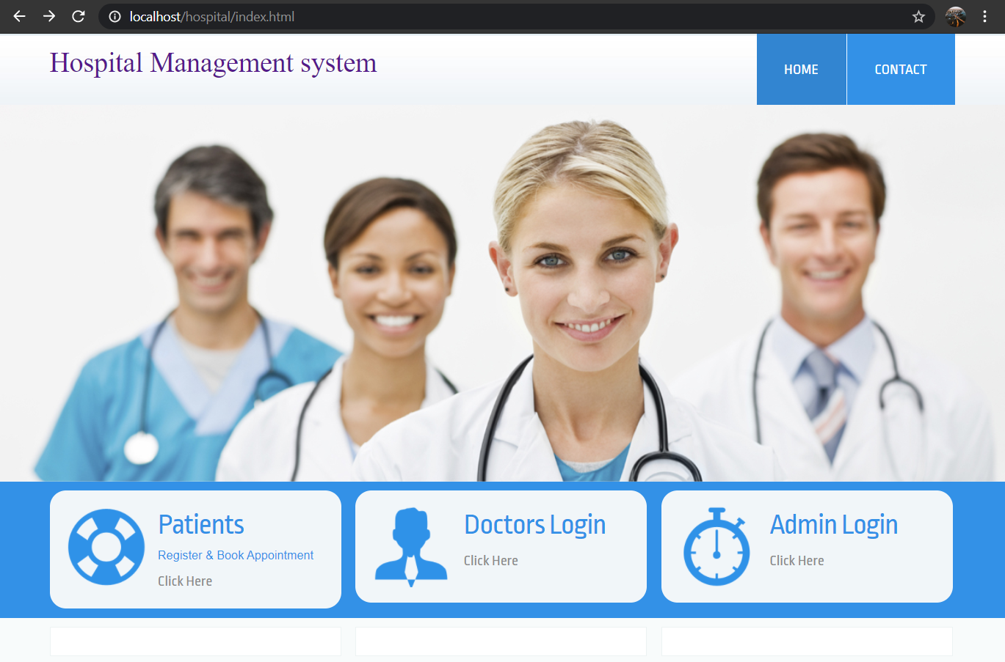
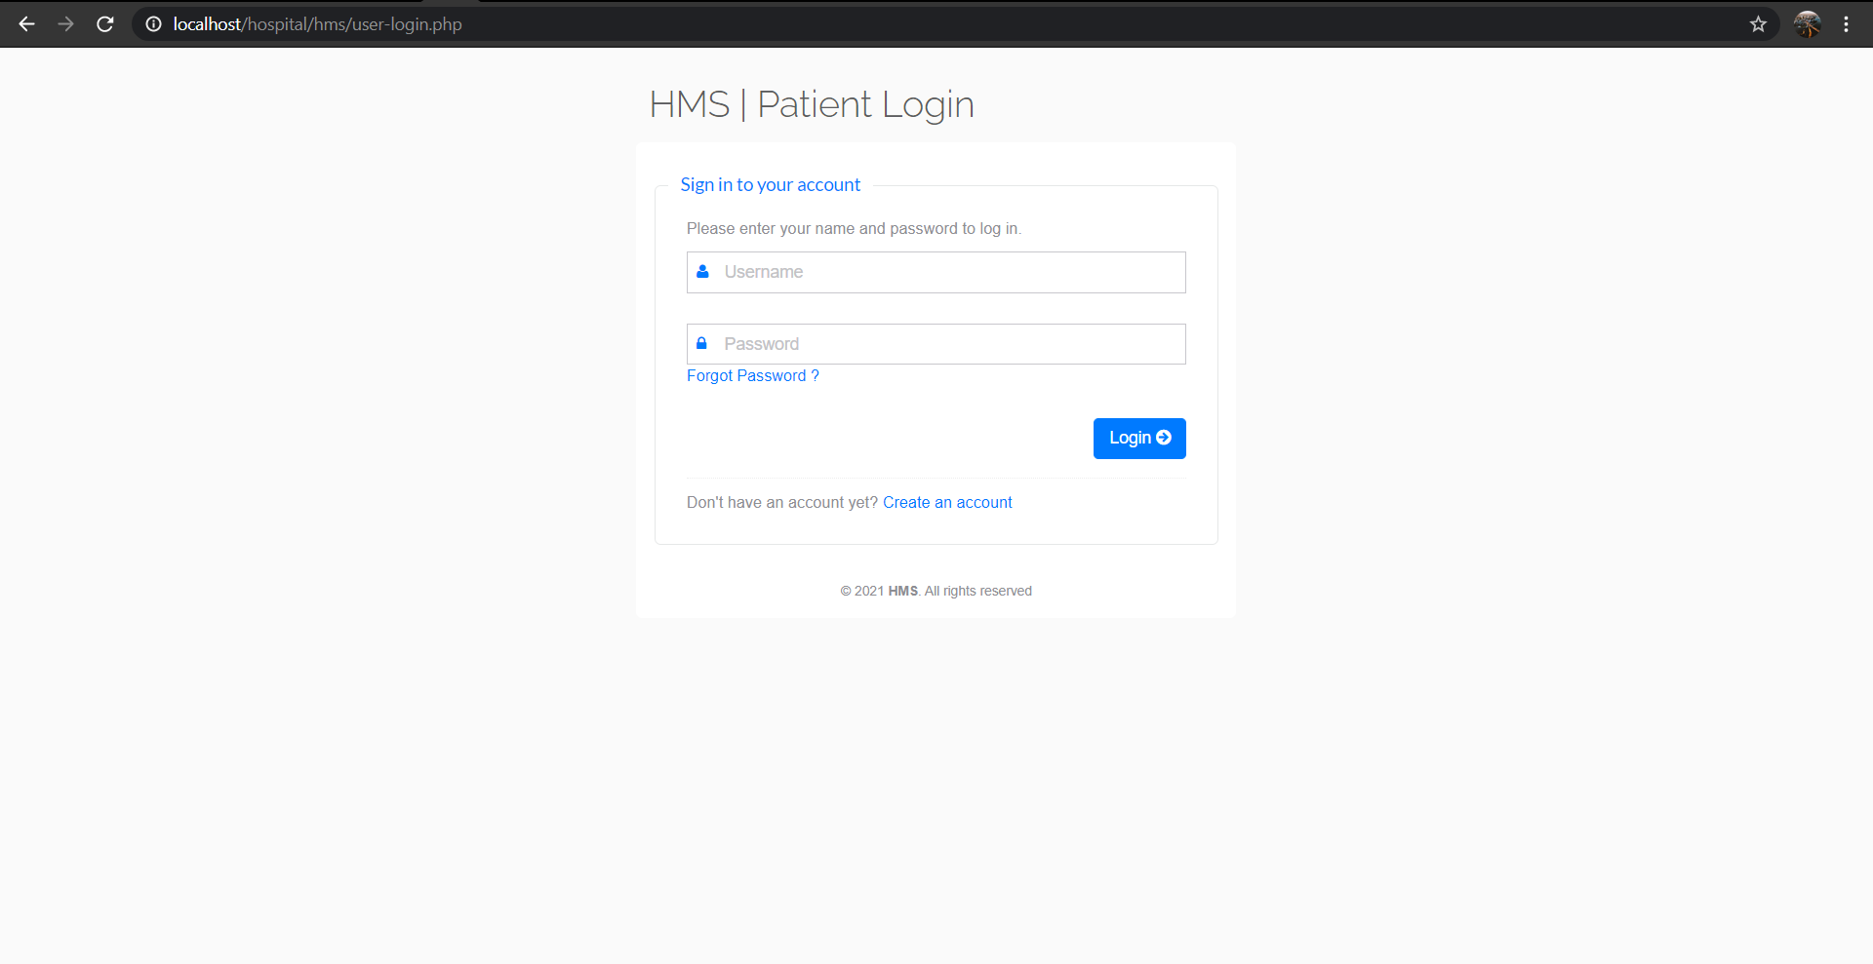

Slide 12
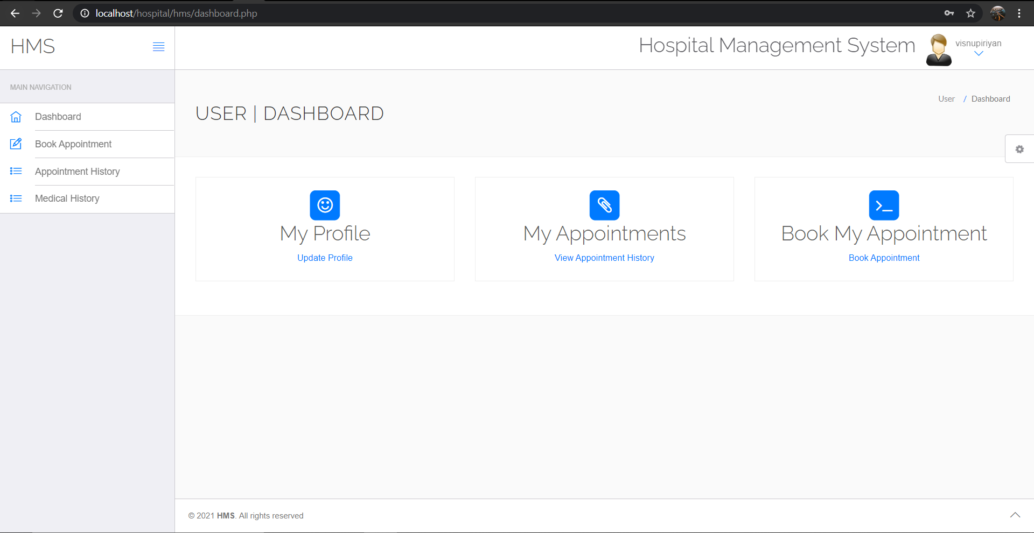
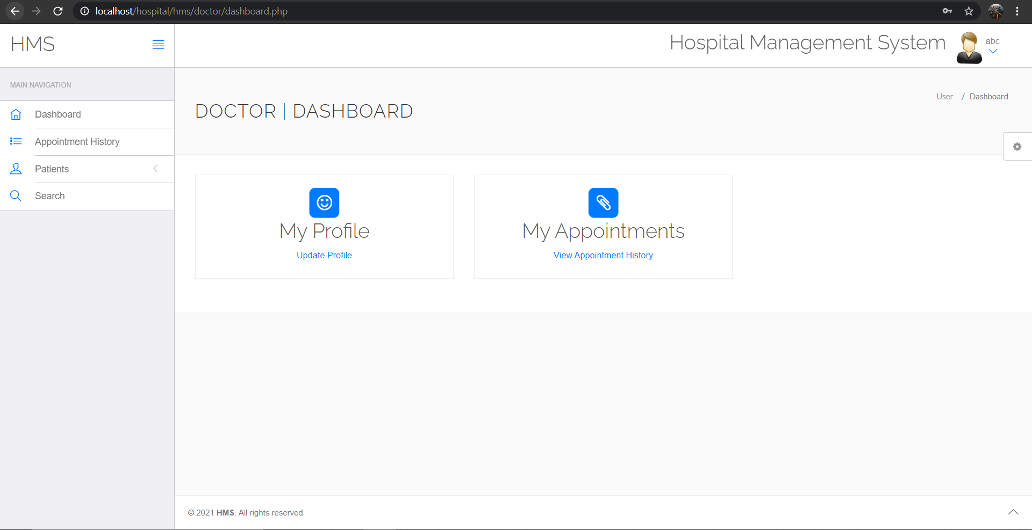

Slide 13
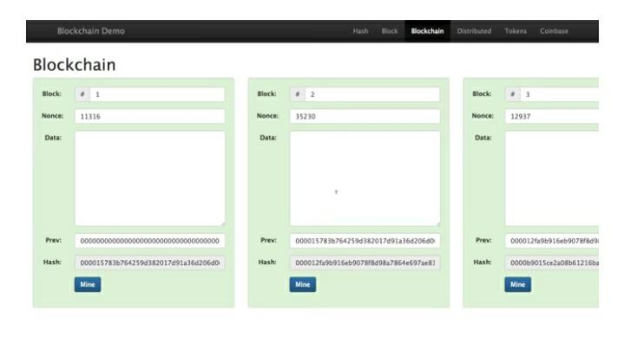
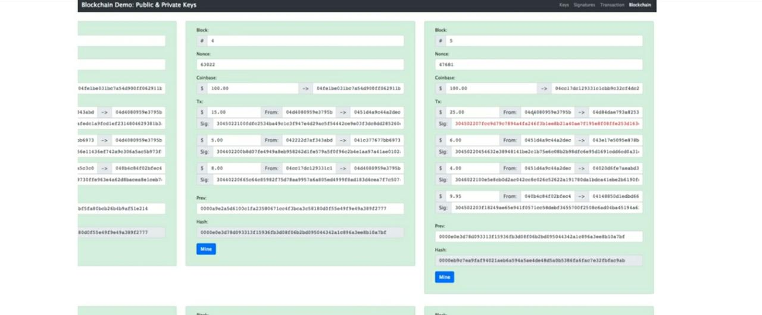
BLOCKCHAIN PROTOTYPE:

Slide 14
THANK YOU

